Slide 1

Anime style transformer
Shuheng Gong
Wei Li

Slide 2
Motivation
The popularity of Anime
The relevance to Comp. Vision
The contribution for art.
The interest to GAN
The convenience of creating Anime
Notes:
We can introduce our culture to others through the medium of Anime
This project is highly relevant to our course.
transforming photos into the styles of famous painters (e.g., transforming a photo to look like a Van Gogh painting).
We interested in anime and GAN, and this project allows us to merge theses passion.
Manually creating anime is very laborious and involves substantial artistic skills. For animation artists, creating high-quality anime works requires careful consideration of lines, textures, colors and shadows, which means that it is difficult and time consuming to create the works. Therefore, the automatic techniques that can automatically transform the real-world to high-quality animation style images are valuable and necessary.

Slide 3
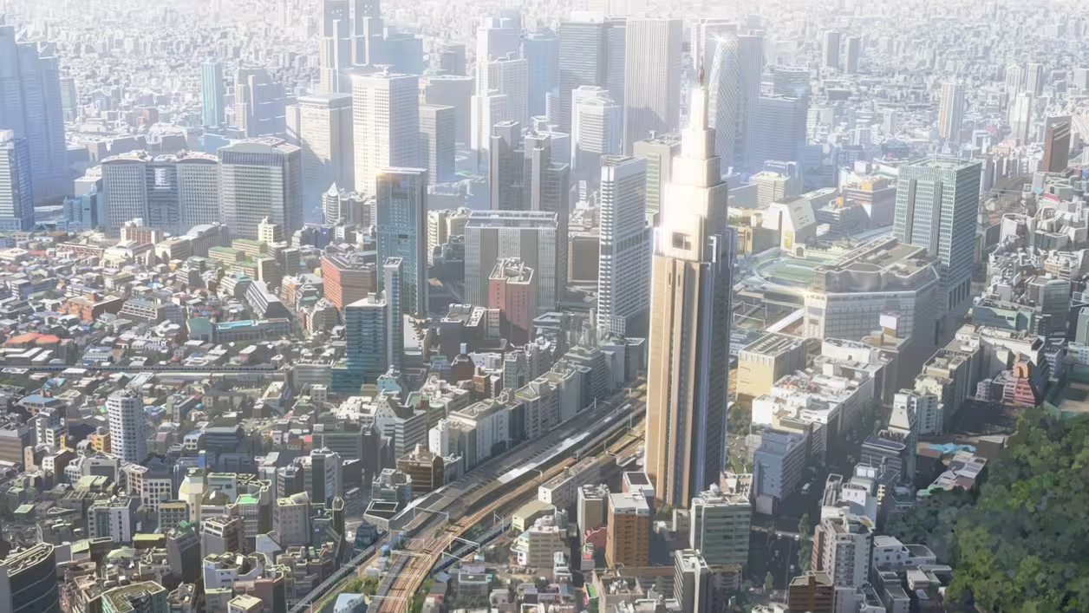
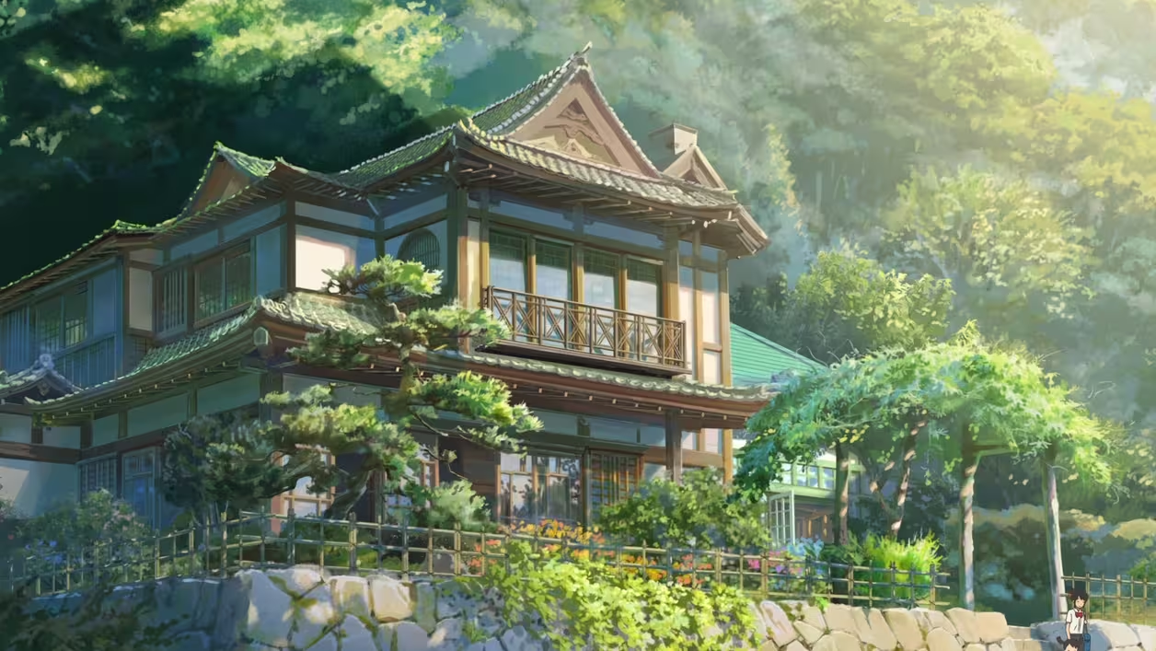
Goal
Our goal is to input a scene photo from the real world, and convert it into an anime-style image in the style of Makoto Shinkai.
Notes:
Detailed Backgrounds: Shinkai's films feature intricately detailed and layered backgrounds. Urban landscapes, rural scenes, and interior settings are portrayed with high detail, ea
ch resembling a meticulously crafted painting.
Color Use: His films employ saturated and rich colors, especially in the rendering of skies and clouds, often using gradients to create a dreamlike visual effect. This enhances the visual impact and deepens emotional expression.
Light and Shadow Effects: Lighting plays a key role in Shinkai's films. He skillfully uses light to create atmosphere, whether it's the warm hues of a sunset or the dampness after rain, linking light changes closely with the story's emotions.

Slide 4
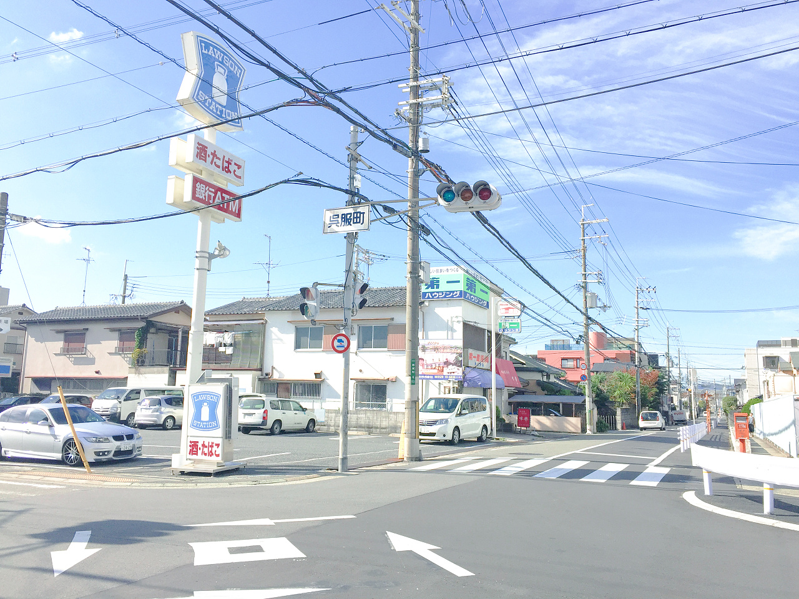
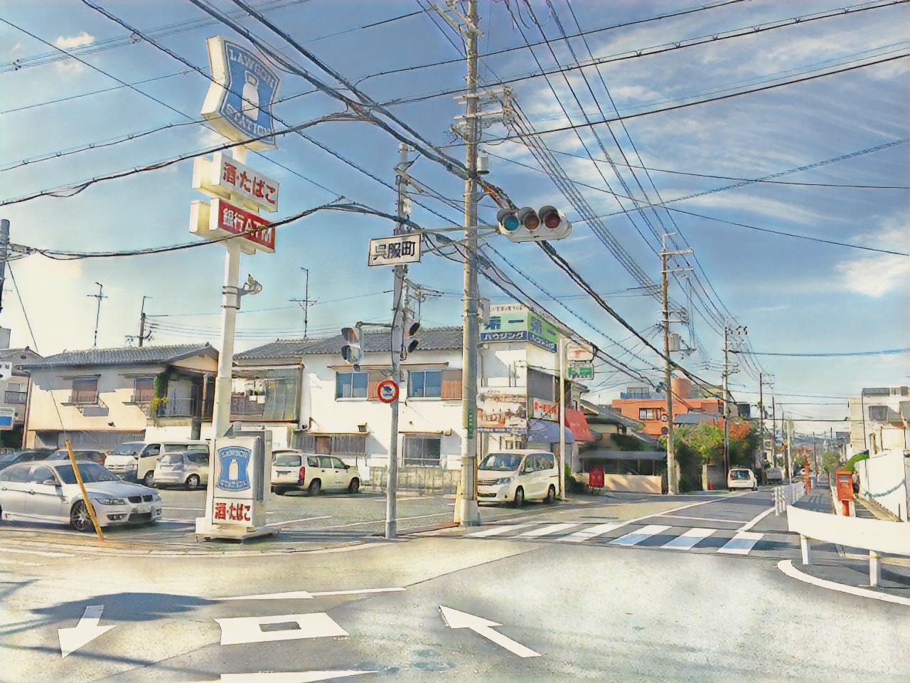
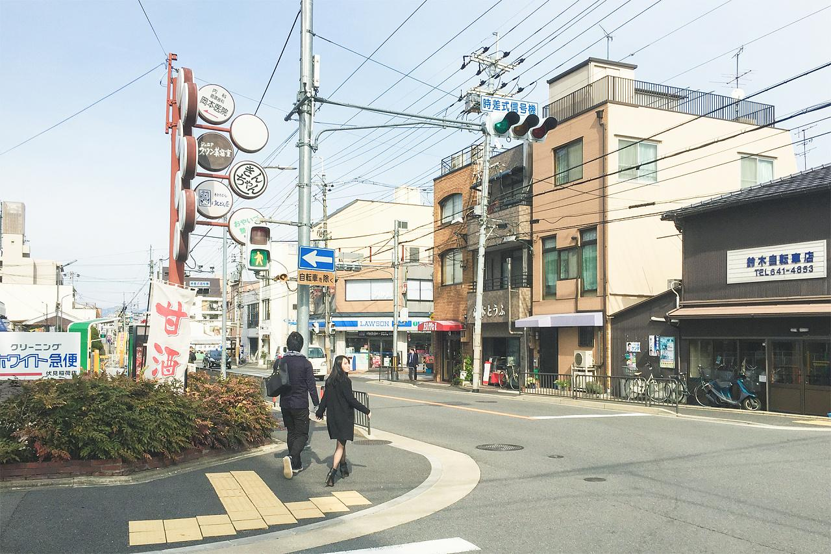
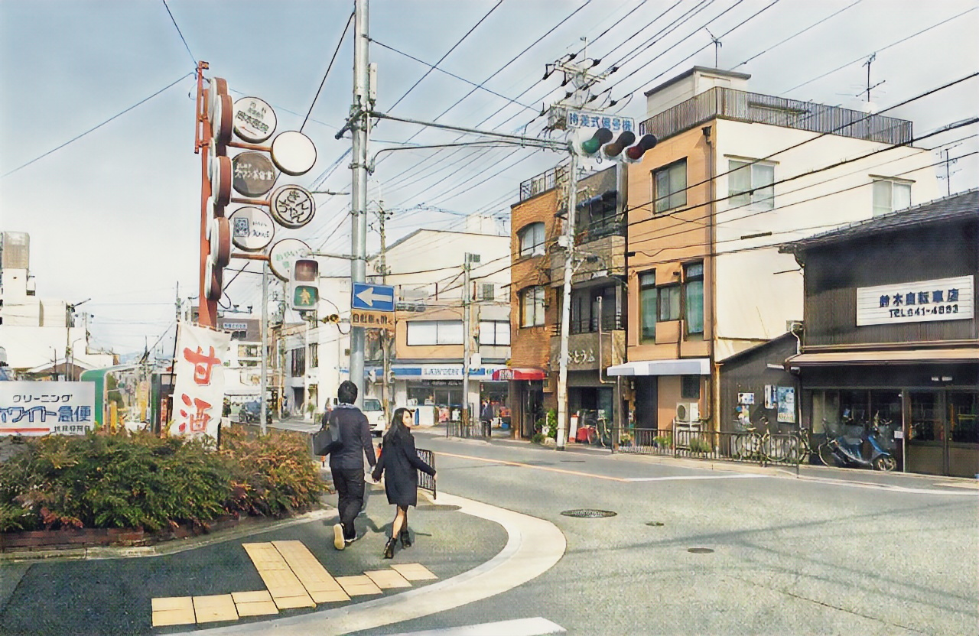
Demos

Slide 5
Method
Taking a set of photos and a set of anime images for training.
Using the unpaired data for training
There is three simple and efficient loss functions.
Notes:
Our method takes a set of photos and a set of anime images for training.
To produce high-quality results while making the training data easy to obtain, we use the unpaired data for training, which means the photos and anime images in the training set are not related in content.
To further improve the animation visual effects of the generated images, there is 3 loss functions(we’ll talk them latter)

Slide 6
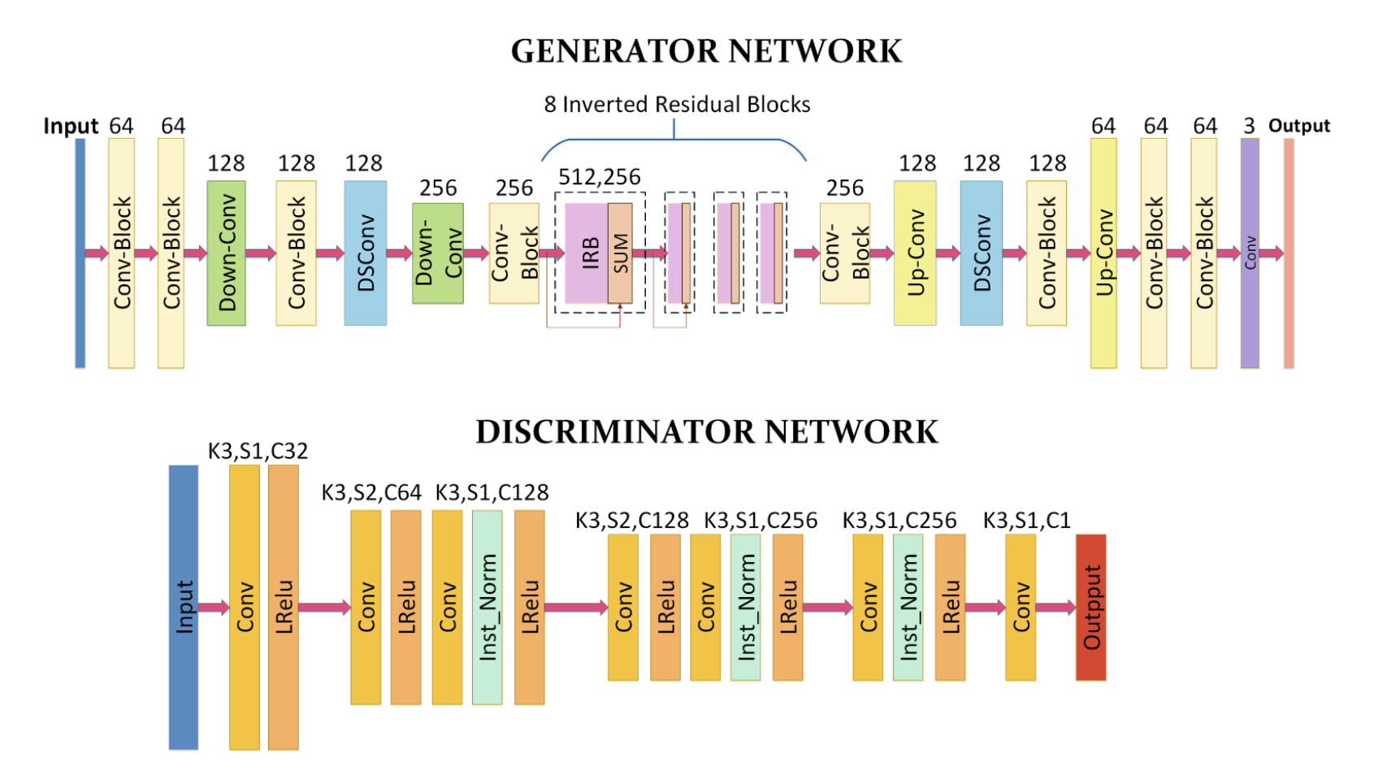
Notes:
Let’s talk about Architecture. This slide shows the generator and the discriminator in the proposed AnimeGAN. AnimeGAN consists of two convolution neural networks: One is the generator G which is used to transform the photos of real-world scenes into the anime images; the another is the discriminator D which discriminates whether the images are from the real target domain or the output produced by the generator.
In the generator, the numbers on all boxes represent the number of channels and SUM means the element-wise sum. In the discriminator, "K" is the kernel size, "C" is the number of the feature maps, "S" is the stride in each convolutional layer and Inst_Norm indicates the instance normalization layer.
The generator of AnimeGAN can be considered as a symmetrical encoder-decoder network, which is mainly composed of the standard convolutions, the depthwise separable convolutions , the inverted residual blocks (IRBs) , the upsampling and downsampling modules. In the generator, the last convolutional layer with 1 x 1 convolution kernels does not use the normalization layer and is followed by the tanh nonlinear activation function.
In order to effectively reduce the number of the parameters of the generator, we use 8 consecutive and identical IRBs in the middle of the network. Compared with the standard residual blocks, IRBs can significantly reduce the number of the parameters and computational workload of the network. IRB consists of the pointwise convolution with 512 kernels, the depthwise convolution with 512 kernels and the pointwise convolution with 256 kernels. It is worth noting that the last convolution layer does not use activation function.
Let’s look at the discriminator. All convolutional layers in the discriminator are the standard convolutions. For the weight of each convolutional layer, the spectral normalization is used to make the network training more stable.

Slide 7
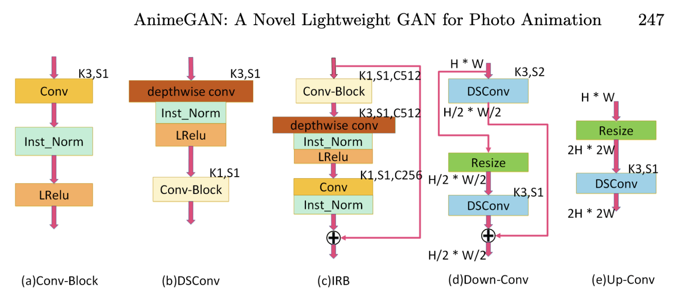
Notes:
Let's look at the next slides which shows The architectures of Conv-Block, DSConv, IRB, Down-Conv and Up-Conv in AnimeGAN.
Conv-Block is composed of the standard convolution with 3 × 3 convolution kernels, the instance normalization layer and the LRelu activation function.
DSConv is composed of the depthwise separable convolution with 3 x 3 convolution kernels, the instance normalization layer and the LRelu activation function.
The IRB contains Conv-Block, the depthwise convolution, the pointwise convolution and the instance normalization layer.
In order to avoid the loss of the feature information caused by max-pooling, the Down-Conv is used as the downsampling module to reduce the resolution of the feature maps. It contains the DSConv module with stride 2 and the DSConv module with stride 1. In Down-Conv, the feature maps are resized to half the size of the input feature maps. The output of the Down-Conv module is the sum of the output of the DSConv module with stride 2 and the DSConv module with stride 1.
Up-Conv is used as the upsampling module to increase the resolution of the feature maps. The feature maps are resized to 2 times the size of the input feature maps.

Slide 8
Four loss functions
Grayscale style loss function:
Makes the generated image have more obvious anime style.
Color reconstruction loss:
Preserves the color of the photos.
Grayscale adversarial loss:
Makes the generated image have vivid color.
Content loss:
Preserves the content of the real-world scenes.
Notes:
In the generative network, the grayscale style loss makes the generated image have more obvious anime style.
The color reconstruction loss preserves the color of the photos. The grayscale adversarial loss in the discriminator network makes the generated image have vivid color
The content loss to make sure the results retain the content of the real-world scenes.

Slide 9
Training details
S_data(P): real-world photos in training sets.
S_data(A): anime images in training sets.
-> To obtain the texture of anime images instead of the color. It is necessary to transform the animation images into grayscale images for eliminating color interference.
S_data(X): The greyscale animation training dataset S_data(X) transformed from S_data(A)
S_data(E): the training data S_data(E) is constructed by removing the edges of the animation images in the training dataset S_data(A).
S_data(Y): we further process the images in S_data(E) into the grayscale images again.
Notes:
S_data(P): real-world photos in training sets.
S_data(A): anime images in training sets.
-> we use the grayscale Gram matrix to make the generated image have the texture of anime images instead of the color of anime images. Therefore, it is necessary to transform the animation images into grayscale images for eliminating color inference.
S_data(X): we transform the S_data(A) into S_data(X). The greyscale animation training dataset S_data(X) corresponding to the color animation domain S_data(A) is obtained.
S_data(E): the training data S_data(E) is constructed by removing the edges of the animation images in the training dataset S_data(A).( This is to make AnimeGAN to learn the non-edge features such as: texture, shadow, and lighting effects.)
S_data(Y):Apart from the initial grayscale conversion, even after the edges have been removed, color information can still undesirably affect the style transfer. Therefore, it is necessary to perform grayscale processing again on the non-edge desaturated images.

Slide 10
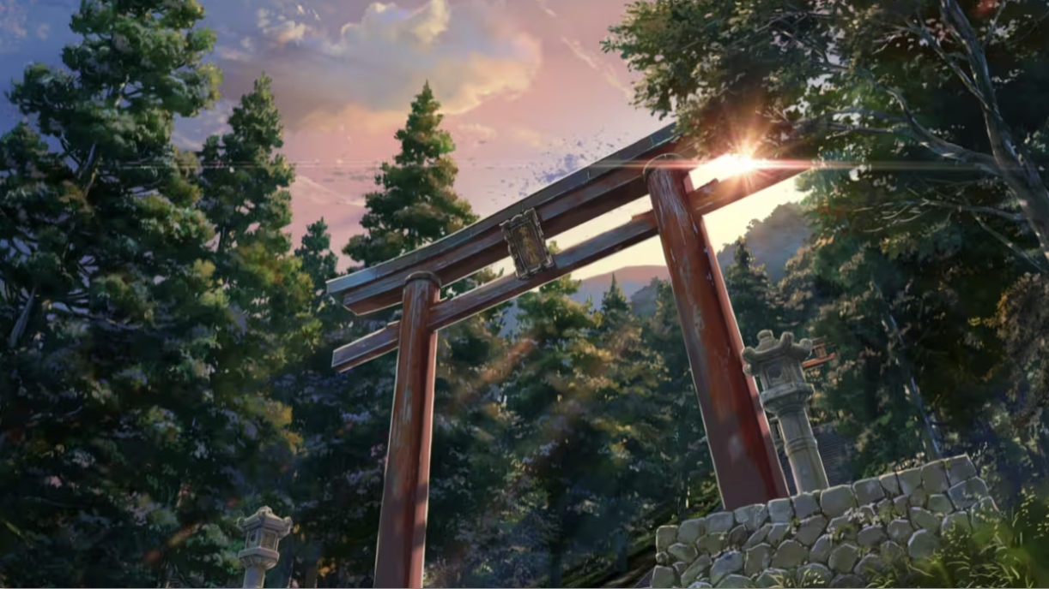
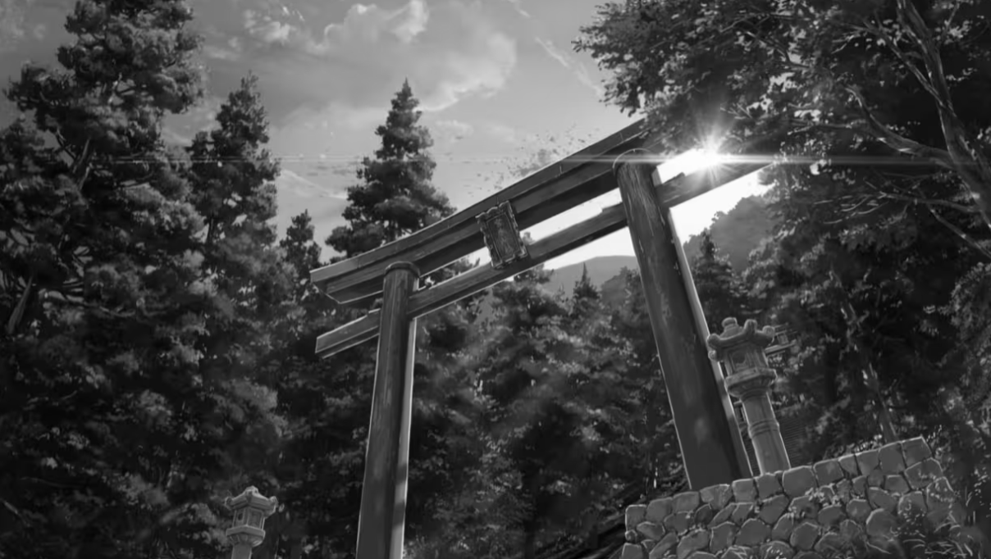
Training details
Processing the image into the grayscale image.
Notes:
This is an example for processing the image into the grayscale image.
( which means we let the animeGAN focus on lines and content rather than color.)

Slide 11
Training details
The total loss calculation:
L_adv(G, D) is the adversarial function loss that affects the animation transformation process in generator G.
L_con(G,D) is the content loss which helps to make generated image retain the content of the input photo.
L_gra(G,D) represents the grayscale style loss which makes the generated image have clear anime style on the textures and lines.
L_col(G,D) is used as color reconstruction loss to make the generated image have the color of the original image.
Notes:
The total loss calculation is here
L_adv(G, D) is the adversarial function loss that affects the animation transformation process in generator G.
L_con(G,D) is the content loss which helps to make generated image retain the content of the input photo.
(If the weight of the content loss is too large, the generated images will be very close to the real-world photos.)
L_gra(G,D) represents the grayscale style loss which makes the generated image have clear anime style on the textures and lines.
If the weight of the grayscale style loss is too large, the generated images will lose the content of the original images.
L_col(G,D) is used as color reconstruction loss to make the generated image have the color of the original image.
In the end, we need to balance the 4 weights to have a satisfactory results , so we set the separately are 300 ,1.5, 3, 10.

Slide 12
Experimental setup
Training data: 6500 real-world photos (content images) and 1800 the anime images(style images). Test data: only includes the real-world photos.
The resolution of all training images: 256 x 256
The learning rate of the generator: 0.00008 The learning rate of the discriminator: 0.00016
Training epoch: 60
Batch size: 8
Adam optimizer is used to minimize the total loss.
Notes:
The proposed AnimeGAN can be easily trained to generate the anime style images with the unpaired data. The real-world photos as the content images and the anime images as the style images are used as the training data, and the test data only includes the real-world photos. The resolution of all training images is set to 256 x 256. For the content images, 6500 real-world photos are employed for training and these photos have been used as the training data for CycleGAN. For the style images, since different animation artists have their own unique animation creation styles, in order to obtain a series of the animation images with the same style, we use the key frames of the animated films drawn and directed by the same artist as the style images. In this experiments, We used python scripts to capture 1500 anime images from the movie 'Your Name' and ‘5 centimeters per second’ directed by Shinkai are used for training the anime style model.

Slide 13
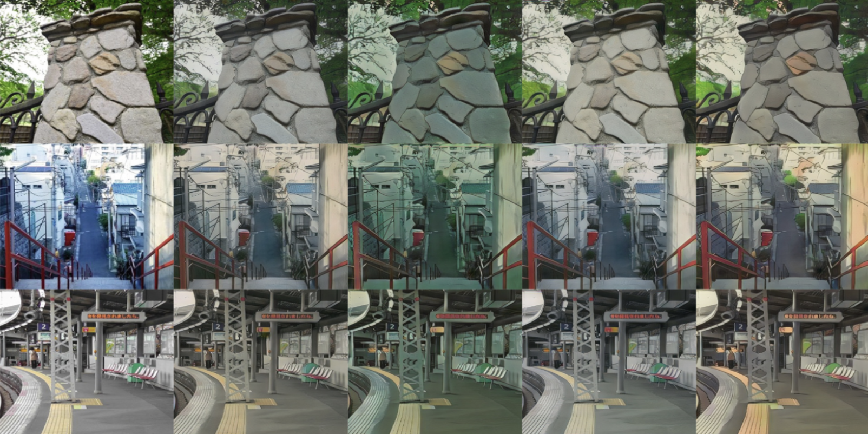
Influence of different weights
Photo w_dav=250, w_col=10 w_dav=350, w_col=10 w_dav=300, w_col=50 w_dav=300, w_col=10
Notes:
To further investigate the effect of the weights on the quality of the generated images. First, we set the weights of the content loss and grayscale loss as 1.5 and 3. And compared to AnimeGAN with different weights of adversarial loss and color loss
When w_adv=250, w_col=10, generated images are closer to the input photo
When w_adv=350, w_col=10, generated images have obvious animation style, but the hue of the generated images will be affected. It have obvious dark green.
When w_adv=300, w_col=50, generated images have more realistic content, but the animation of the images is not obvious.
When w_adv=300, w_col=10, the images generated by animeGAN have the satisfactory animated visual effect.

Slide 14
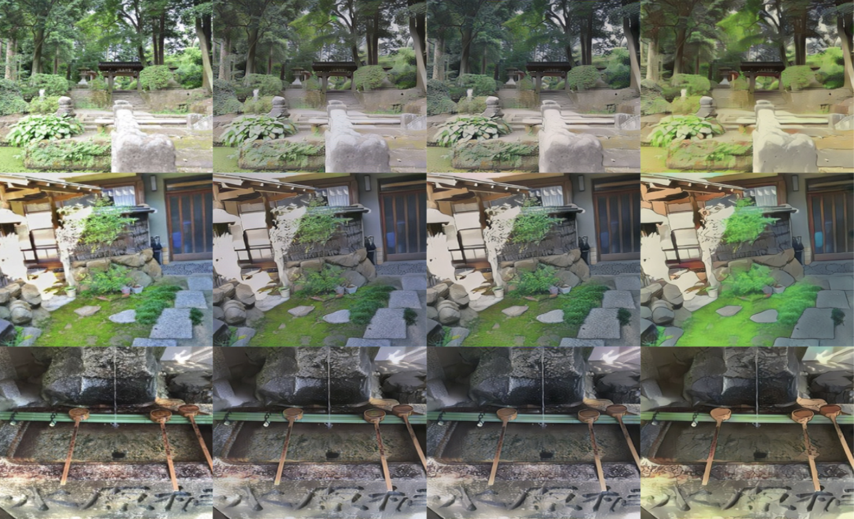
Influence of different weights
A: without using grayscale loss.
B: without using Grayscale adversarial loss
C: generated by AnimeGAN with good performance
Photo A B C
Notes:
To further study the effect of grayscale images on the results.
A indicates the inference results generated by AnimeGAN without using the grayscale adversarial loss. B indicates the inference results generated by AnimeGAN using the blurred color edge images in S_data(E), for the edge-promoting adversarial loss.
C indicates the inference results generated by AnimeGAN
The results in A and B are similar.
The difference between C and B is that the edge-blurred color images are processed into the grayscale images to avoid the color effects of the edge-blurred images on the generated results.
Compared with C, The colors in A are not rich enough and saturated. Hence, the grayscale adversarial loss can promote the generated images to have a more saturated color.

Slide 15
Main reference works
Github:
https://github.com/Abel3369/pytorch-animeGAN

Slide 16
Thanks

